Slide 1
Amorphous MgO Triple Junctions
12/07/16

Slide 2
Geometric case
Three crystals extended until they meet at the centre of the triple junction.

Slide 3
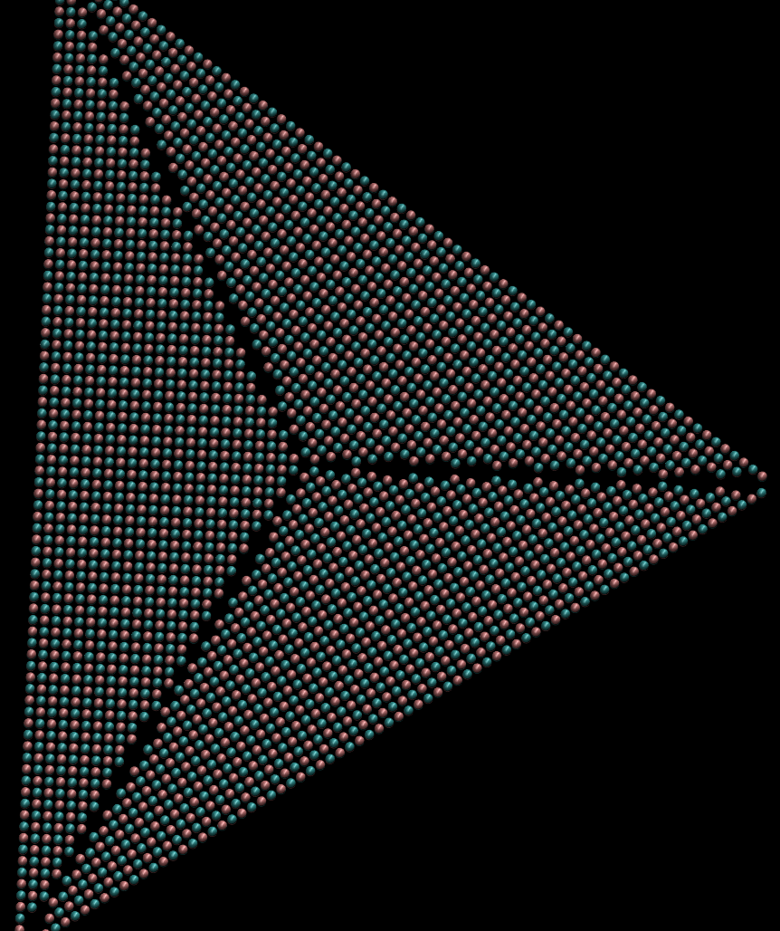
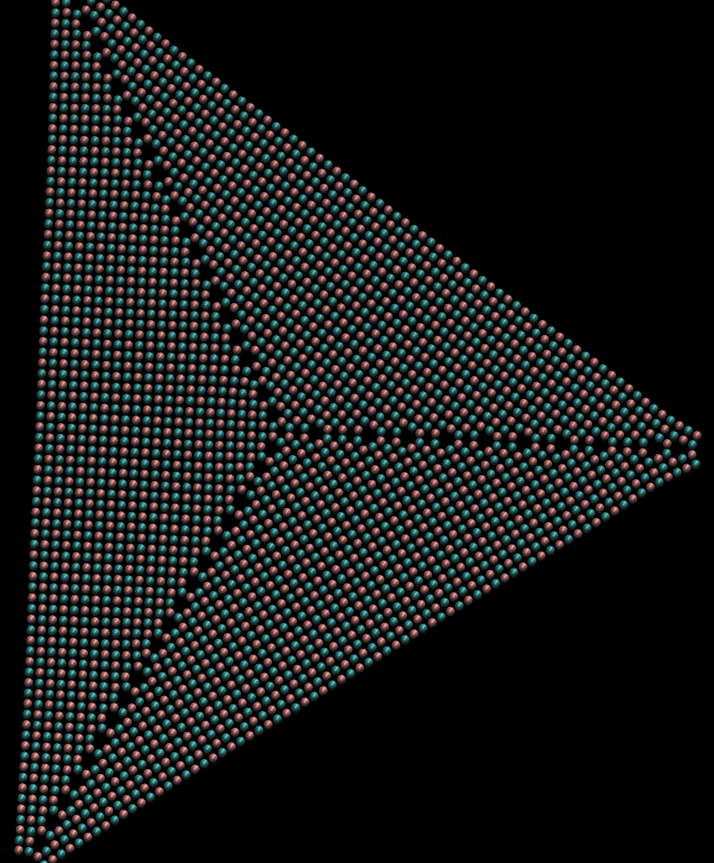

Slide 5
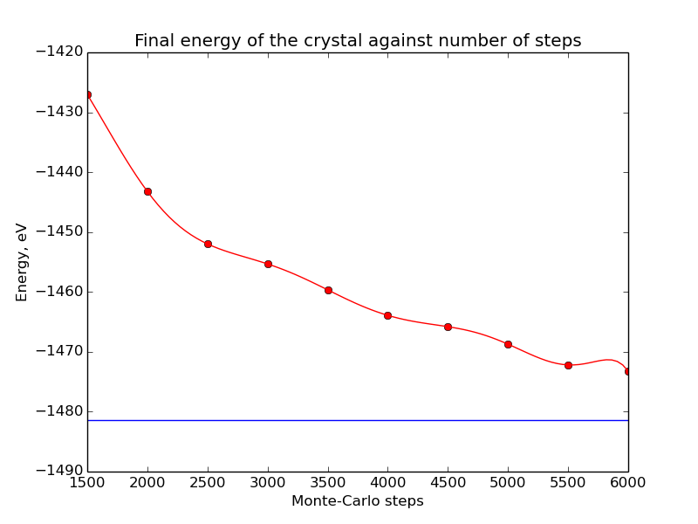
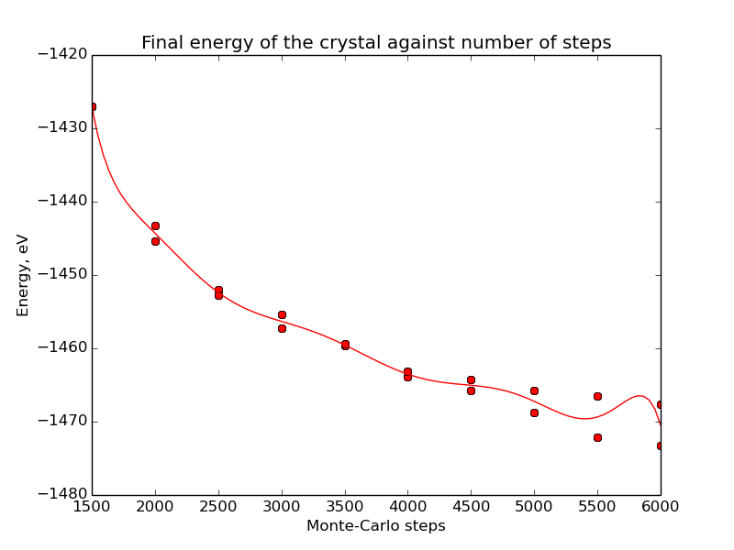
Random Searching with a test cell

